Slide 1
Brazilian E-commerce from Olist
Author: Ahmed Nasser
Date: 2024-03-20

Slide 2
Presentation summary
Introduction
Exploring the data
Find the customer segmentation
Create Churn Analysis
Design a Predictive Model
The recommendations
Appendix

Slide 3
Introduction
As a senior data analyst working at a fast-growing e-commerce platform, Olist, based in Brazil.
The company operates a marketplace connecting sellers and buyers across various product categories.
My task is to analyze the available dataset to derive actionable insights to improve business operations and customer experience, by first answering the business objectives.
In this analysis case study, I'll use the six steps of the data analysis process, which is (Ask, Prepare, Process, Analyze, Share, and Act).

Slide 4
Exploring the data

Slide 5
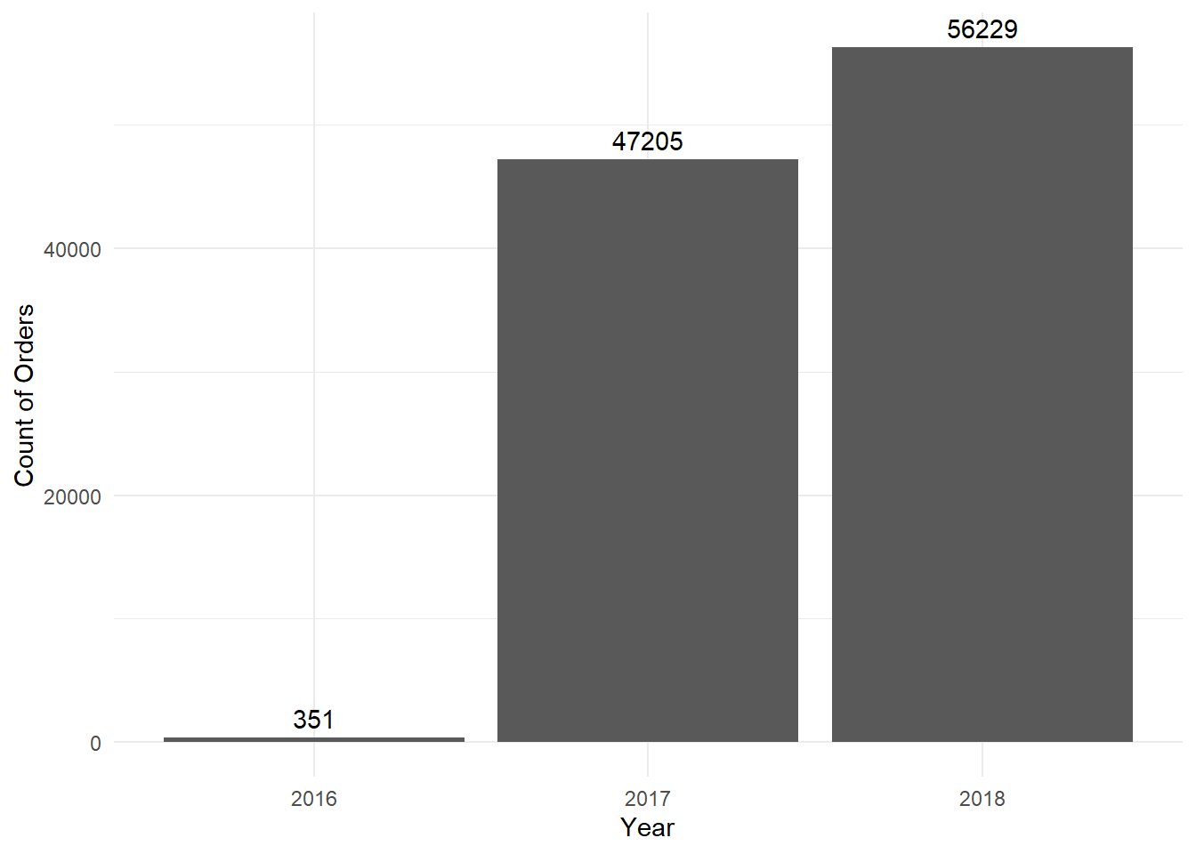
Company Summary
The overall yearly trend indicates that the company is experiencing rapid growth, with a 19% growth rate in the last year.
Orders | Current month | Last month | Historical month | Median | Highest month
Volume | 6790 | 6533 | 4550 | 4550 | 7934
Revenue | 1125306 | 1162720 | 764429 | 817058 | 1348281
Growth% | - | 3.93% | 49.23% | 49.23% | (-14.42%)
From the table above we notice that the Volume growth rate is around 4% from the last month, and 50% from the same month last year.

Slide 6
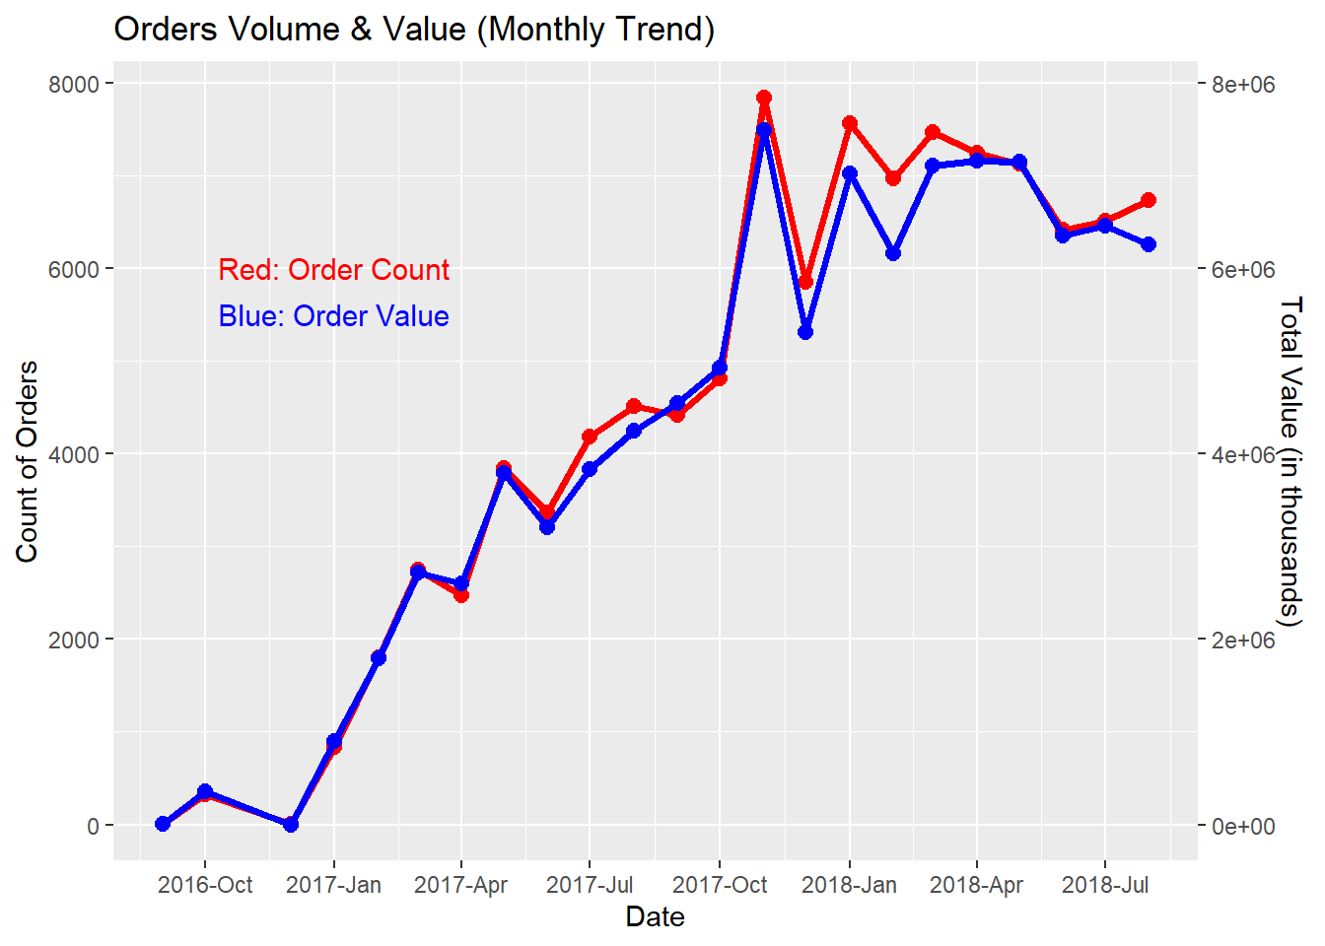
Orders trend
Orders | Lowest month | Avg orders monthly | Highest month
Volume | 1 | 4512 | 7934
Value | 19.62 | 777396.3 | 1348281
From this visual we notice that the company started at the end of 2016, and with a noticeable increase in the end of 2017
And a near-stability in volume till the med of 2018

Slide 7
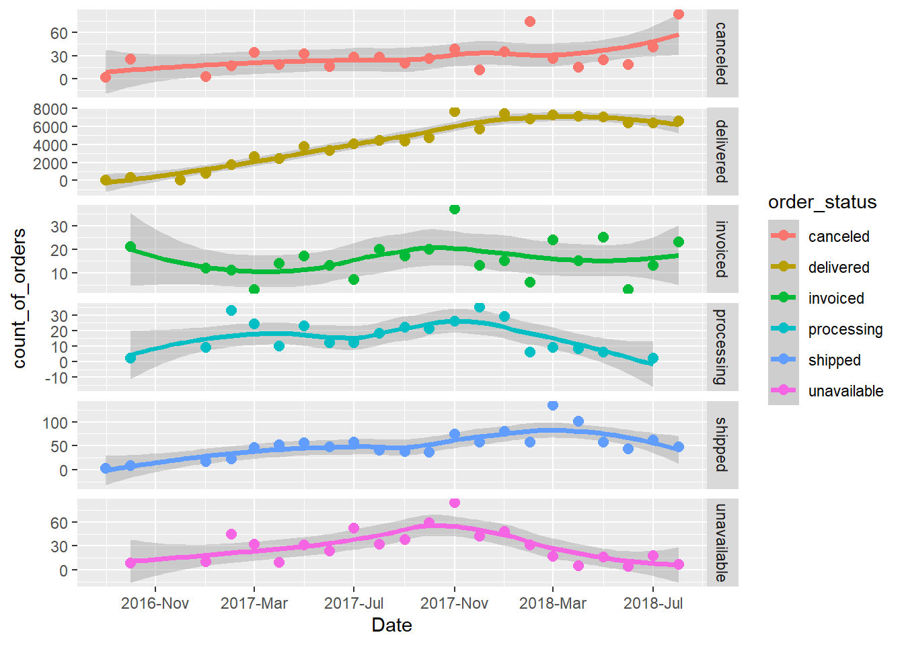
Order status
Regarding this chart we notice that delivered orders are increasing over time, supporting that the number of orders are increasing

Slide 8
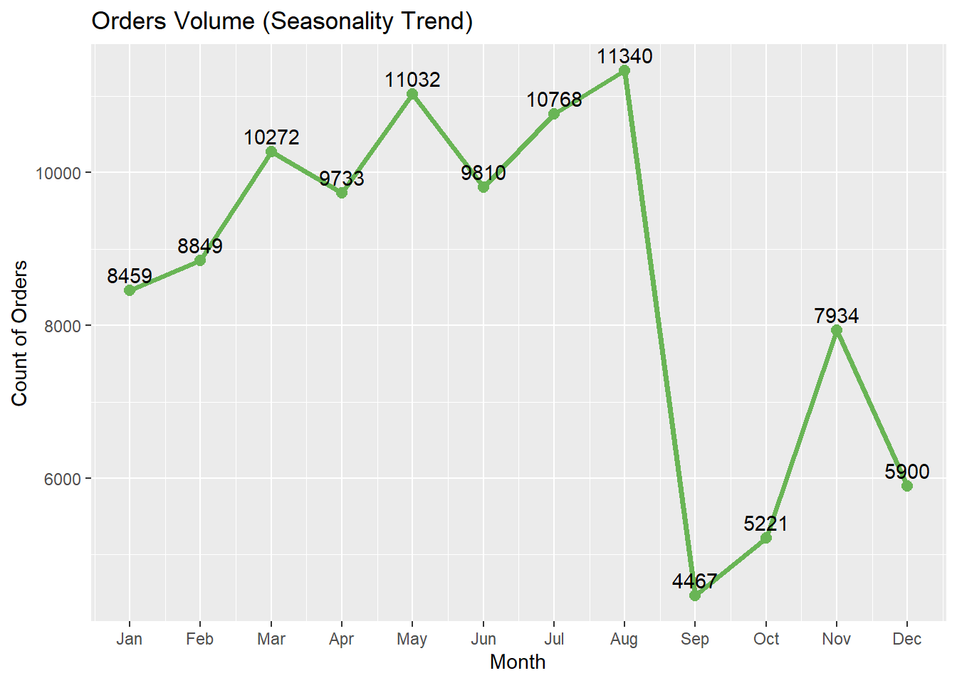
Seasonality trend
This visual shows that there’s seasonal trend starting from March till August.

Slide 9
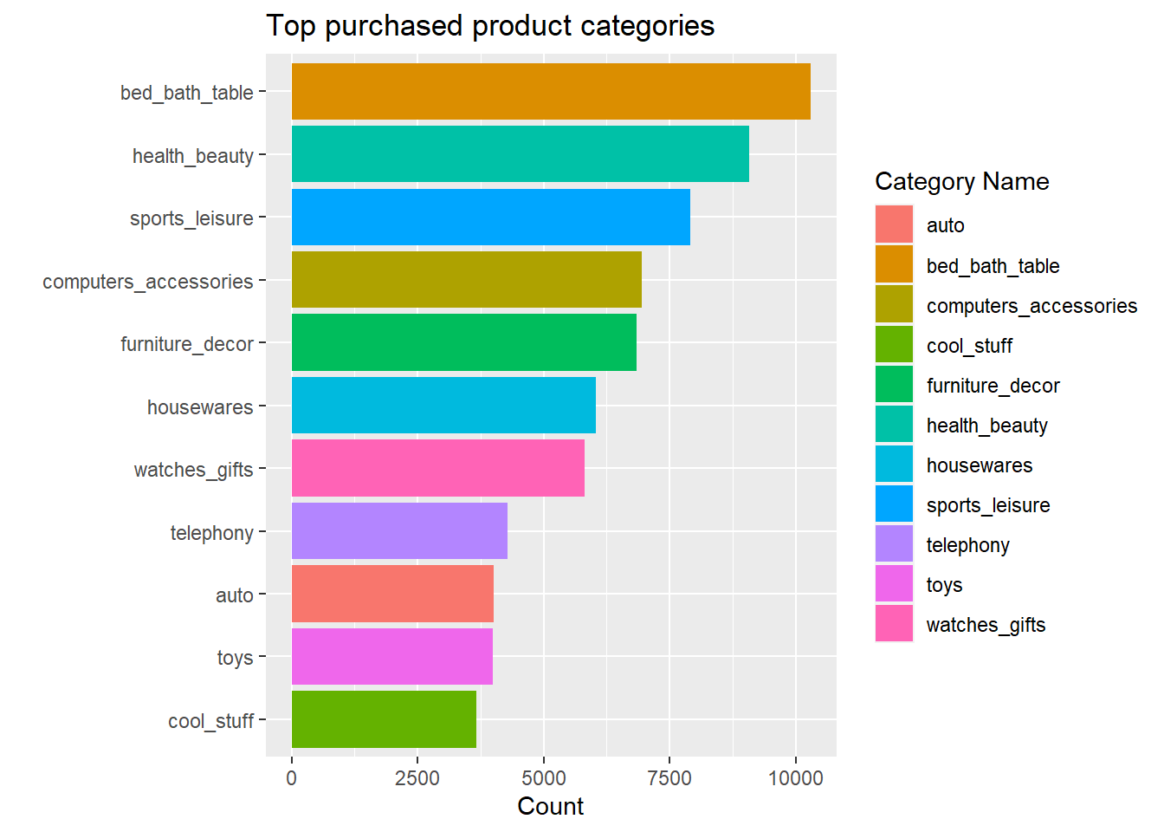
Most purchased products
The best-selling categories are related to home furniture, beauty products, and sports

Slide 10
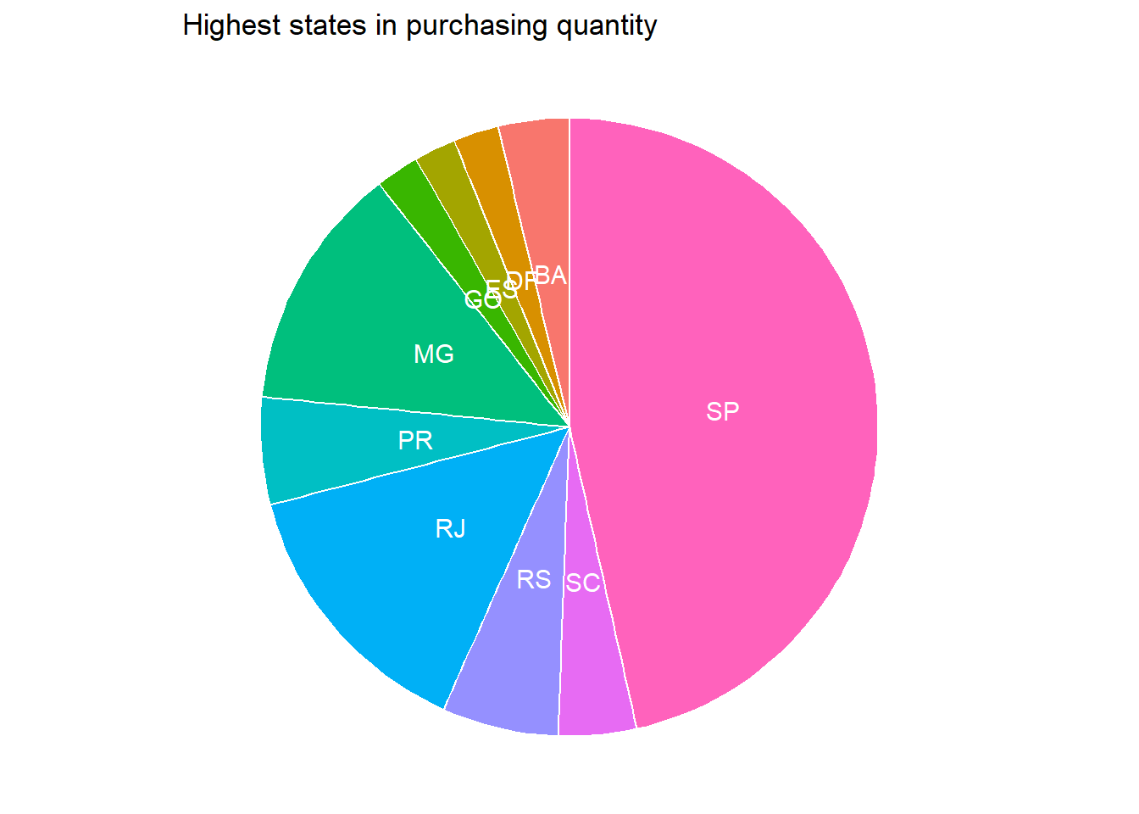
Highest states
The highest states in purchasing quantities are SP, RJ, and MG

Slide 11
customer segmentation

Slide 12
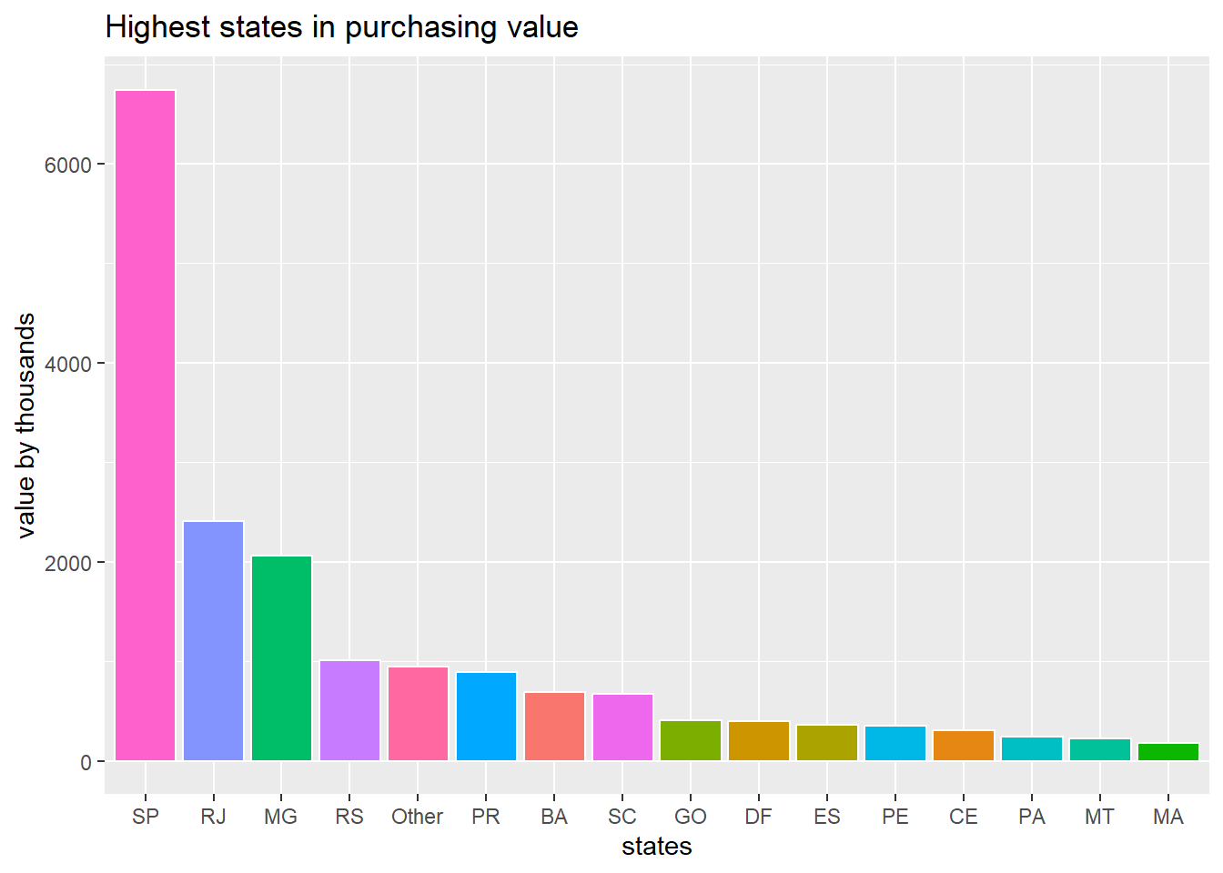
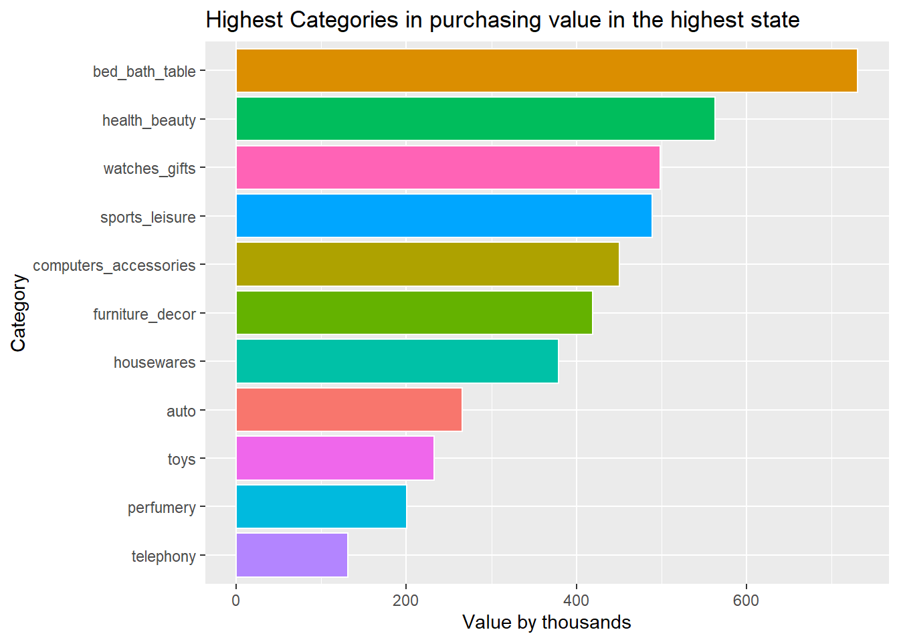
Highest states
The highest states in purchasing value are SP, RJ, and MG.
Highest Categories in purchasing value in the highest state (SP)

Slide 13
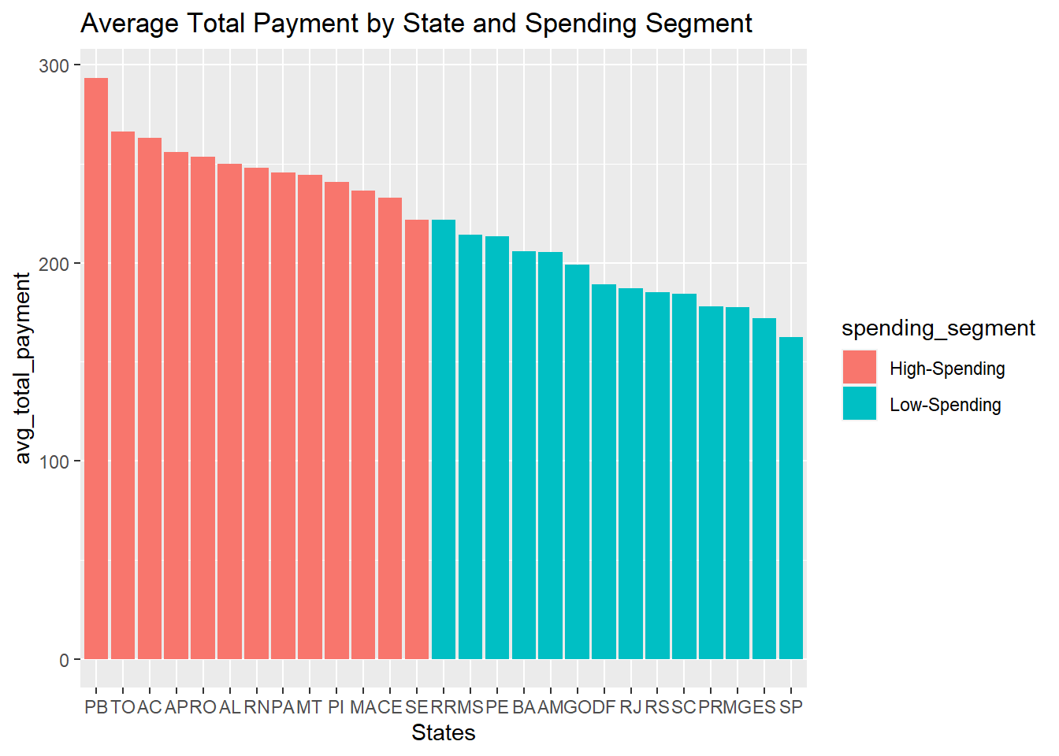
states in spending
Below is the states’ average spending (Highest/Lowest)

Slide 14
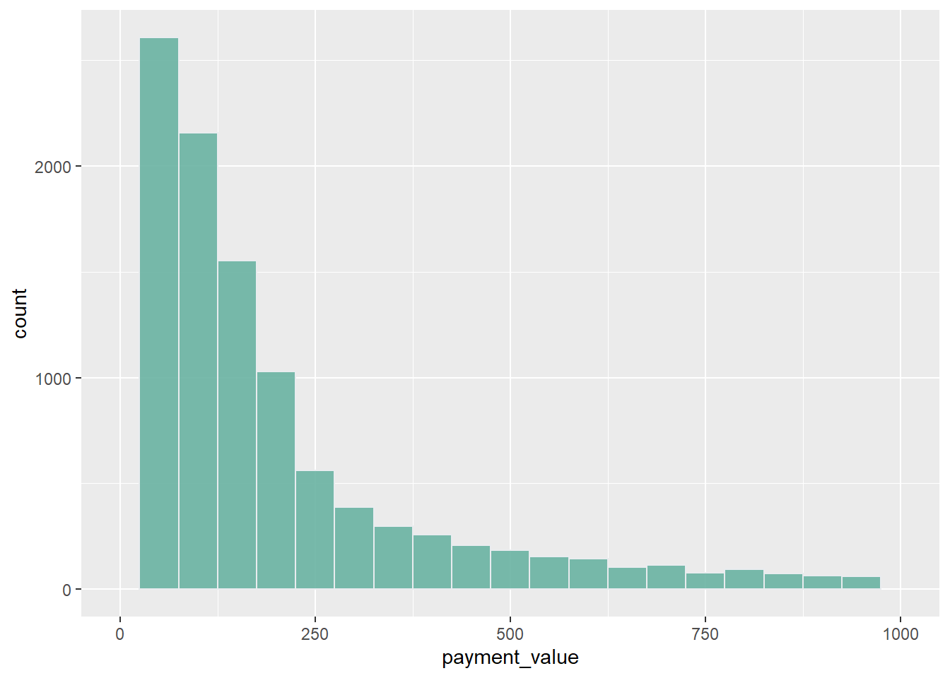
Payments distribution
Regarding the payments value distribution, we found that most selling products are between 50 - 250

Slide 15
Churn Analysis

Slide 16
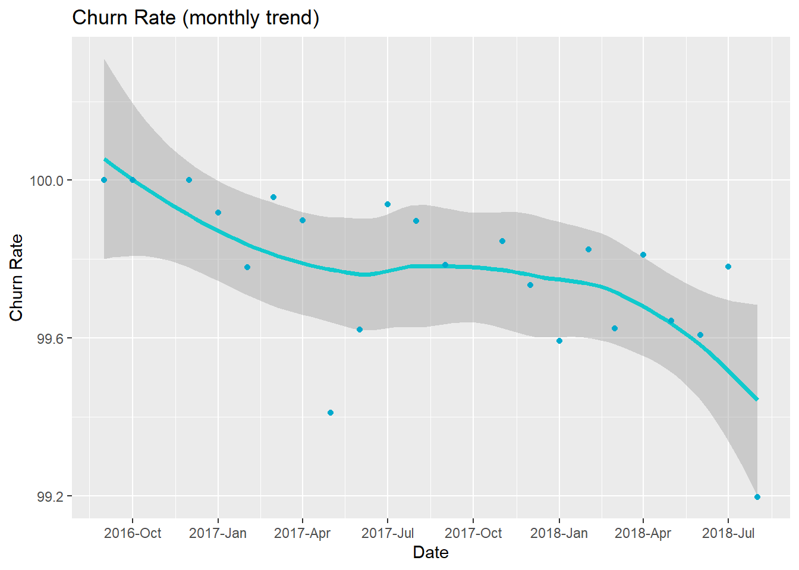
Churn Rate
As we can see the churn rate was 100% until the first quarter of 2017, then started to decrease slowly.
Overall Churn Rate is 99.76%, and Retention is 0.24%

Slide 17
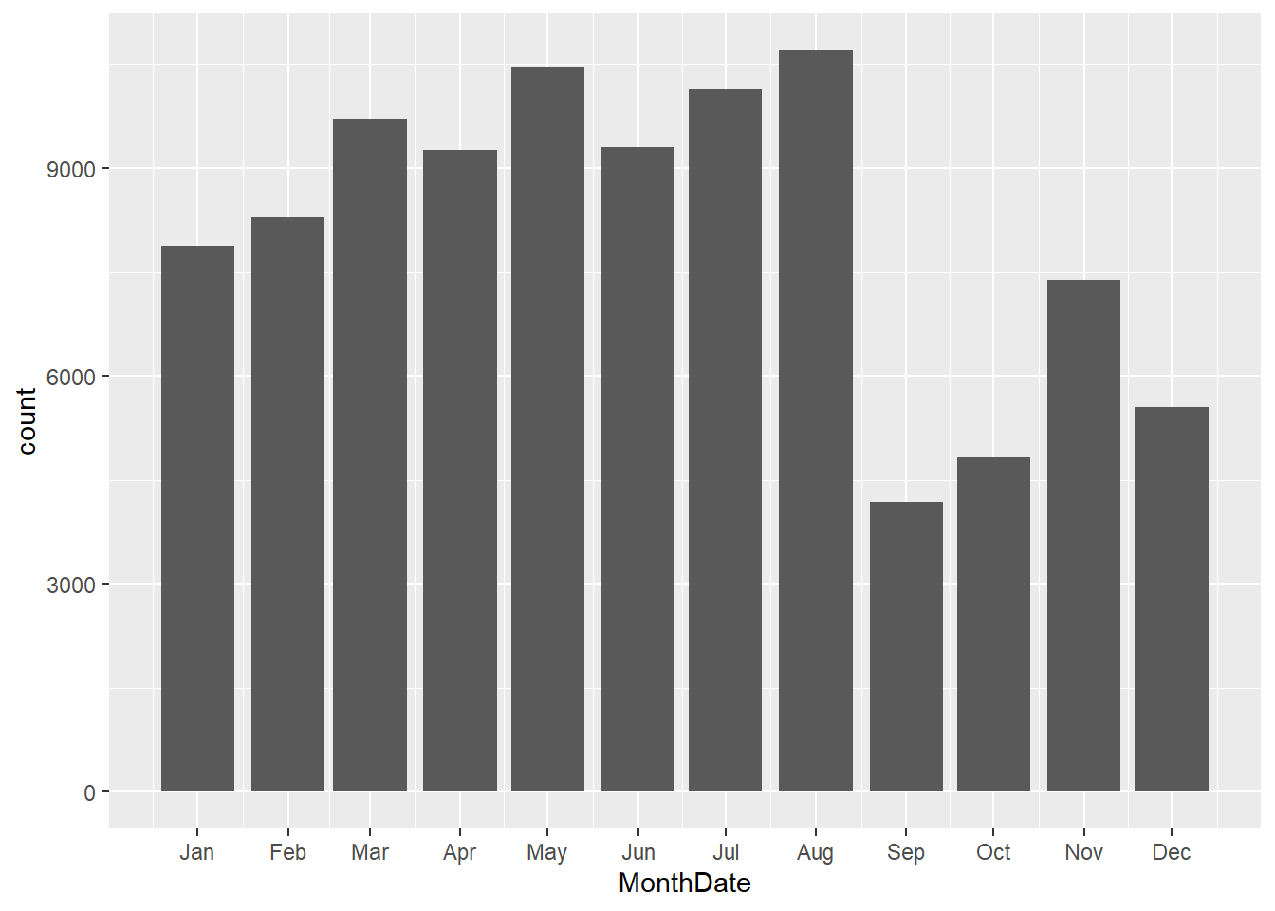
Monthly ChurnRate
This visual showing months with high churn rate over the years

Slide 18
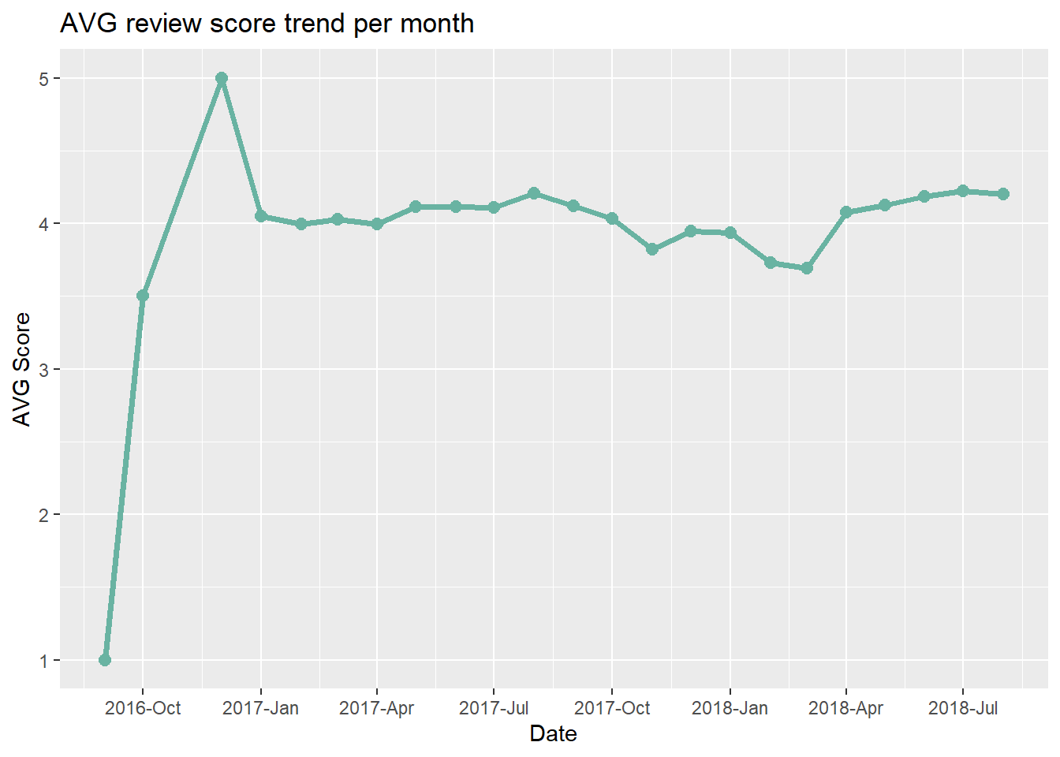
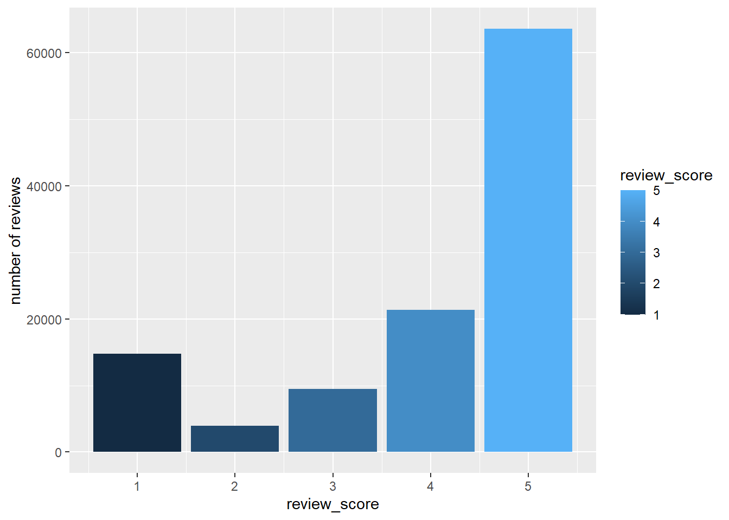
Review score
The review score was at its peak at the beginning, then dropped to around 4
The overall review score is 5

Slide 19
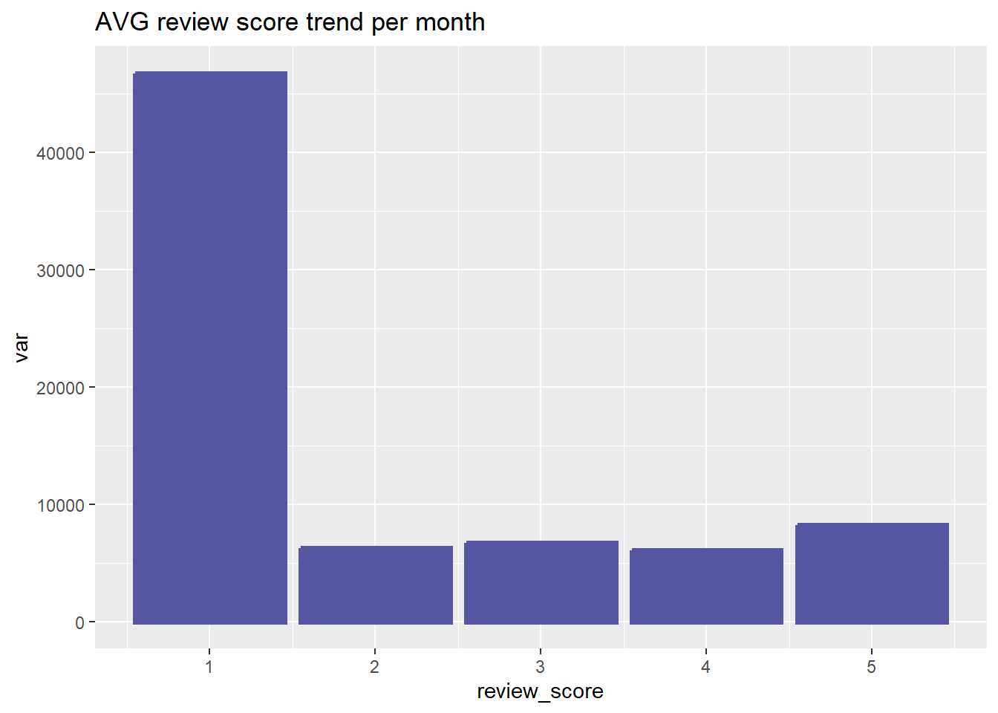
Delay impact
Caused by the delay
The delay in order delivery negatively impact the review score.
And contribute with 33.83% of the overall low score.

Slide 20
Predictive Model

Slide 21
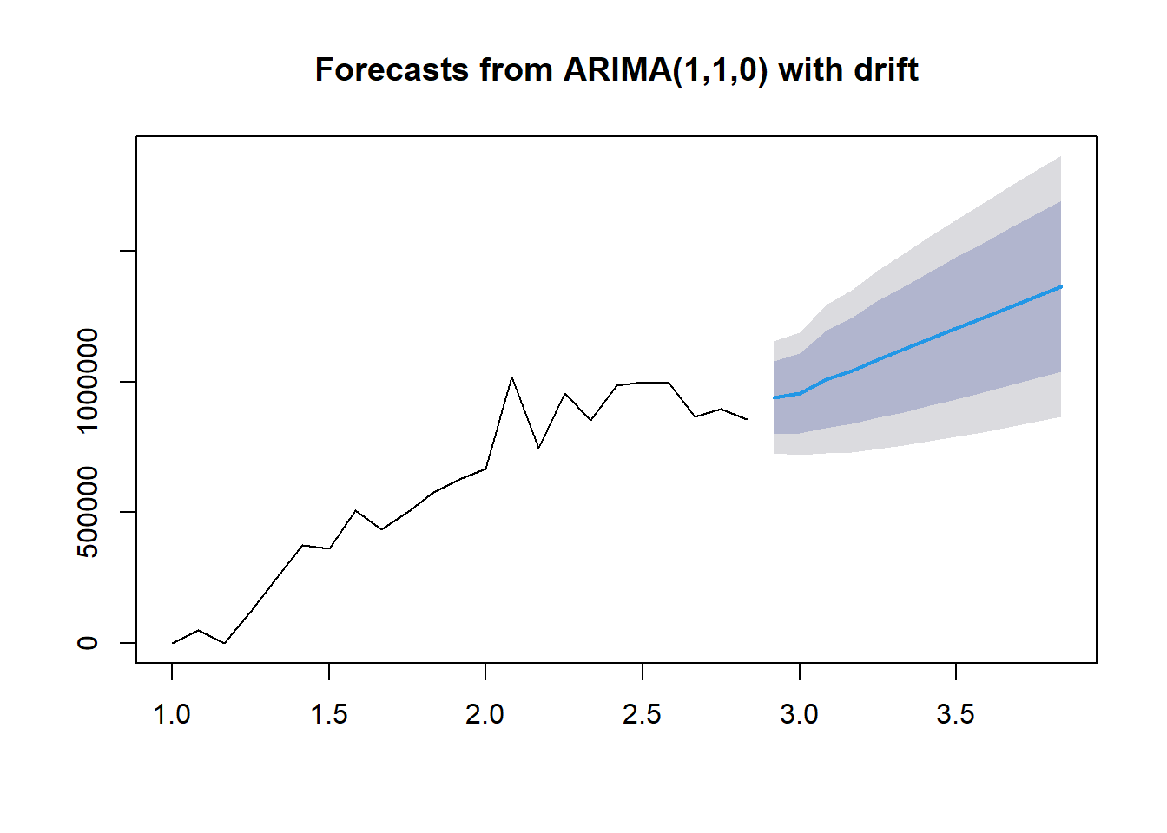
Predictive Modeling
After conducting a churn analysis on the customer segment using the purchasing behavior and geographic location, I created a predictive model to forecast the next 12 months.

Slide 22
The recommendations

Slide 23
Findings & Recommendations
Findings
Recommendations
The company is on a growing scale since the beginning, with around 20% growth rate in the last year.
Seasonality trend starts from March till August.
Most selling categories are related to home furniture, beauty products, and sports.
The highest states in purchasing value are RJ, MG, and PR.
The payments value distribution are between 50 – 250.
The company’s rating is overall high, but the order delivery delay have a high impact on the low ratings.
Develop a main dashboard with the most selling categories in the company user’s app.
Prioritize the low-price items in the search feature in the user’s app, to enhance the customer experience.
Minimize the order delivery duration, to enhance the customer’s reviews score or increase the estimated delivery time to develop honesty with the customers.
Cooperation with the SEO team to increase the advertising in the highest states and cities in purchasing, to increase the customer base.

Slide 24
Appendix
Link for the documentation files on GitHub:
github.com/a7mdNasrr/Olist-Brazilian-E-commerce-Analysis-Project

Slide 25
THANK YOU
Ahmed Nasser, Data Analyst
Email: a-n-ahmed@hotmail.com
Portfolio: a7mdnasrr.github.io/AhmedNasser.github.io

